Slide 1
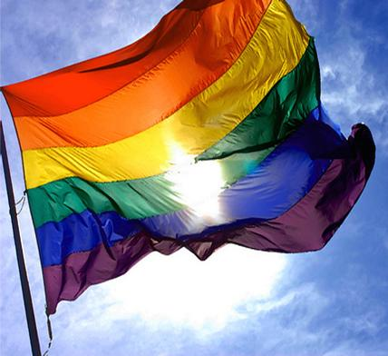
Don’t Ask, Can’t Report
A Practical Guide to Collecting Data on Lesbian, Gay, Bisexual & Transgender People in a Culturally Responsive Way

Slide 2
Who Are We?
Emily Greytak
Senior Research Associate
GLSEN (Gay, Lesbian &
Straight Education Network)
Efrain Gutierrez
Associate
FSG
Kari Greene
Senior Research Analyst
Program Design and
Evaluation Services
Now…Who Are You?
Notes:
I would like to know who is in the room? Evaluators? Level of experience working with LGBTQ community? Queers?
Good idea about knowing who is in the room. If we have 10 people or more, I'd suggest a quick stand up or hand raise asking about level of experience/expertise or something working wtih LGBTQ community or something. Maybe ask in general and then could ask if they have working on evaluation that includes or is for LGBTQ etc. or something, we could figure it out. I'm assuming that everyone there (at the conference) are evaluators, am I wrong?

Slide 3
Agenda
Introduction
Facilitators, Participants, LGBT TIG
Session Overview
Working with LGBT Communities
Terminology
3 Topics for Evaluators to Be Aware Of
Identifying LGBT People in Evaluation Research: What, When, & How to Ask
Adults
Youth
Group Discussions (Questions &Special Topics)
Conclusion

Slide 4
Lesbian, Gay, Bisexual, and Transgender (LGBT) Issues TIG
Provides visibility of and support for LGBT issues within AEA
Promotes better understanding of LGBT issues
Develops and sponsors LGBT-focused conference programs
Provides support and guidance for evaluators working with LGBT related issues
Further enhances and supports the diversity efforts within AEA and our profession.

Slide 5
LGBT Issues in AEA
Get involved!
Join the LGBT Issues TIG
Attend TIG-sponsored conference sessions
Submit session to TIG for 2013 conference
Come to business meeting or social next year
Submit LGBT-related articles to AEA journals

Slide 6
Overview of the Session
Participant Objectives
Become familiar with LGBT-specific terminology and with key issues affecting the LGBT community
Learn ways to make evaluation activities more inclusive and respectful of LGBT people
Identify data collection items and best practices to use when collecting LGBT-specific data
Why should I care about this topic?
Cultural diversity is a reality in the U.S.
Issues of equity for a disenfranchised community
LGBT individuals are served by nearly all programs and services, but often invisible in the data

Slide 7
LGBT-Related Terminology

Slide 8
Terminology Activity: Directions
Everyone gets either a term (orange) or a definition (white)
Circulate around the room to find your “match”
Once you find your match, take a seat together
Discuss briefly each of your experience with this term in your evaluation work (if any)

Slide 9
Sex, Gender, & Sexuality: Basics
Sex (Biological/Assigned)
This is typically determined by our chromosomes, our hormones and our internal and external genitalia. Usually, we are assigned the sex of male or female at birth.
Notes:
Gender roles/expression vary by culture, defined by society – the fact that something is considered “masculine” or “feminine” is determined by culture (e.g.)

Slide 10
Sex, Gender, & Sexuality: Basics
Sex (Biological/Assigned)
Gender Identity
How we identify ourselves in terms of our gender. Identities may be: male, female, androgynous, transgender, genderqueer and others
Notes:
Gender roles/expression vary by culture, defined by society – the fact that something is considered “masculine” or “feminine” is determined by culture (e.g.)

Slide 11
Sex, Gender, & Sexuality: Basics
Sex (Biological/Assigned)
Gender Identity
Gender Expression
An individual’s physical characteristics, behaviors and presentation that are linked, traditionally, to either masculinity or femininity, such as: appearance, dress, mannerisms, speech patterns and social interactions
Notes:
Gender roles/expression vary by culture, defined by society – the fact that something is considered “masculine” or “feminine” is determined by culture (e.g.)

Slide 12
Sex, Gender, & Sexuality: Basics
Sex (Biological/Assigned)
Gender Identity
Gender Expression
Sexual Orientation
What we call ourselves in terms of our sexuality and/or the inner feelings of who we are attracted or oriented to romantically and sexually
Notes:
Gender roles/expression vary by culture, defined by society – the fact that something is considered “masculine” or “feminine” is determined by culture (e.g.)

Slide 13
Traditional Binary Gender Model (adapted from Samuel Lurie)
Sex (Biological/ Assigned) Male Female
Hormones, genitalia, chromosomes secondary sex characteristics
Gender Identity Boy/Man Girl/Woman
I am . . .
Gender Expression Masculine Feminine Dress, actions, presentation
Sexual Orientation
Attracted to . . Girls/Women Boys/Men
Sexual behavior with . . . Girls/Women Boys/Men
Identify as . . . Heterosexual Heterosexual
Notes:
Gender roles/expression vary by culture, defined by society – the fact that something is considered “masculine” or “feminine” is determined by culture (e.g.)

Slide 14
Authentic Gender Model (adapted from Samuel Lurie)
Sex (Biological/Assigned)
Hormones, genitalia, chromosomes secondary sex characteristics
Gender Identity
I am . . .
Gender Expression Dress, actions, presentation
Sexual Orientation
Attracted to . . . Sexual behavior with . . .
Identify as . . .
Male Intersex Female
(Boy/Man ) Unique (Girl/Woman)
Masculine Androgynous Feminine
Girl/Woman None Both Neither Other Boy/Man
Gay Bisexual Asexual Straight Other Lesbian
Notes:
People are not necessarily one or the other; people change over time, not only two binary options
I still don’t LOVE this because it positions male/female, etc.

Slide 15
Authentic Gender Model (adapted from Samuel Lurie)
Sex (Biological/Assigned)
Hormones, genitalia, chromosomes secondary sex characteristics
Gender Identity
I am . . .
Gender Expression Dress, actions, presentation
Sexual Orientation
Attracted to . . Sexual behavior with . . .
Identify as . . .
Male Intersex Female
(Boy/Man ) Unique (Girl/Woman)
Masculine Androgynous Feminine
Girl/Woman None Both Neither Other Boy/Man
Gay Bisexual Asexual Straight Other Lesbian
Notes:
People are not necessarily one or the other; people change over time, not only two binary options
I still don’t LOVE this because it positions male/female, etc.

Slide 16
Gay
Sex, Gender, & Sexuality: Identities
A sexual orientation and/or identity of a person who is emotionally and sexually attracted to some members of the same sex/gender

Slide 17
Lesbian
Sex, Gender, & Sexuality: Identities
A sexual orientation and/or identity of a person who is female-identified and who is emotionally and sexually attracted to some other females

Slide 18
Bisexual
Sex, Gender, & Sexuality: Identities
A sexual orientation and/or identity of a person who is emotionally and sexually attracted to some males and some females

Slide 19
Transgender
Sex, Gender, & Sexuality: Identities
An identity of a person whose gender identity is not aligned with their sex assigned at birth; Sometimes used as a broad “umbrella” term to also include people whose gender expression is nonconforming

Slide 20
Queer
Sex, Gender, & Sexuality: Identities
An “umbrella” term used to describe a sexual orientation, gender identity or gender expression that does not conform to dominant societal norms

Slide 21
Questioning
Sex, Gender, & Sexuality: Identities
An identity or description of a person who is uncertain of their sexual orientation/identity and/or their gender identity

Slide 22
Three Topics Evaluators Should Be Aware of when Engaging with the LGBT Community

Slide 23
Why Am I Doing This Presentation?
My experience as a privileged gay Mexican man living in a progressive city in the United States
Eye-opening experience during a panel after a gay documentary
The questions that came to my head after this experience
Why didn’t I see it?

Slide 24
Why Am I Doing This Presentation?
The evaluation practice can benefit from evaluators that understand their place in society, their biases, and their privilege
This is what cultural competency should be about. Understanding who we are, what we bring to the table, and be open to learn from and understand others
“Cultural competence is a stance taken toward culture, not a discrete status or simple mastery of particular knowledge and skills.”
AEA Statement on Cultural Competence in Evaluation

Slide 25
Three Topics Evaluators Should Be Aware of When Engaging with the LGBT Community
The LGBT community replicates patterns of sexism, racism, and classism prevalent in our society
The diversity of voices within the LGBT community is not usually represented in the movement
The issues concerning the LGBT community are broader than marriage or HIV

Slide 26
1. The LGBT Community Replicates Patterns of Sexism, Racism, and Classism Prevalent in Our Society
The problems affecting underrepresented groups also affect the LGBT community
Being queer creates a “multiplier” effect for women and people of color
The Issues
LGBT families of color are more likely to be living in poverty compared to other groups
Inadequate access to resources for LGBT people of color
Consequences
Be open and prepared to discuss social issues when engaging with LGBTs
Don’t generalize
Account for the “multiplier” effect
Technique

Slide 27
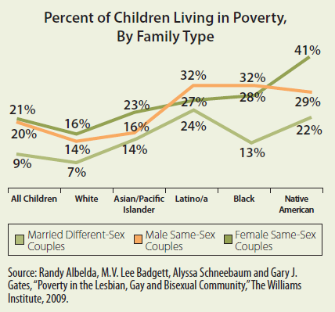
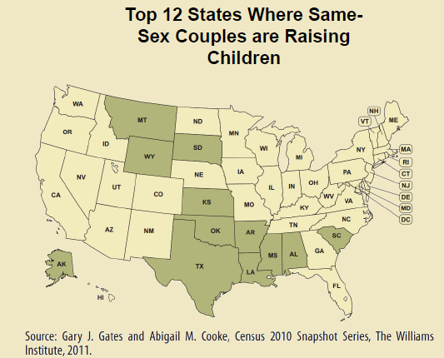
Evaluators Need Their Data…
Source: All Children Matter: How Legal and Social Inequalities Hurt LGBT Families, co-authored by The Movement Advancement Project, the Family Equality Council, and the Center for American Progress

Slide 28
2. The Diversity of Voices within the LGBT Community Is Not Usually Represented in the Movement
Gay social and political activist circles remain almost entirely non-trans, male, and white
Companies and political campaigns aggressively cater the upscale, non-trans, mostly male, and mostly white gays
The Issues
The way the LGBT community is portrayed in media
The popular narrative is not focusing on the challenges of the wide range of LGBT members
Consequences
Don’t complain about how hard it is to find people of color to participate in focus groups and interviews
Consider the different voices of the LGBT community in your evaluation
Technique

Slide 29
3. The Issues Concerning the LGBT Community Are Broader than Marriage or HIV
Internal discussion within the LGBT movement between assimilation or integrationist politics vs. a bottom up LGBT grassroots movement for social justice
The Issues
Marriage became the main issue of the movement
Divide between those members of the LGBT community who “fit” and those not assimilated into the mainstream
Consequences
Use evaluation to bring out the voices of those who are normally ignored
Consider the broad range of social issues affecting the recipients of the program you are evaluating
Technique

Slide 30
Conclusion
These three elements are interrelated and reflect some of the challenges in our society
These issues deserve a deeper discussion
The experience of queers around the world differs considerably
If you want to learn more please read:
All Children Matter: How Legal and Social Inequalities Hurt LGBT Families, co-authored by The Movement Advancement Project, the Family Equality Council, and the Center for American Progress
A Fragile Union by Kai Wright. ColorLines Magazine 2009
How Gay Stays White and What Kind of White It Stays by Allan Berube. Privilege: a reader (book)
Building a Movement from the Ground Up from the Family, Community & Sexuality Project. Western States Center

Slide 31
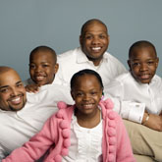
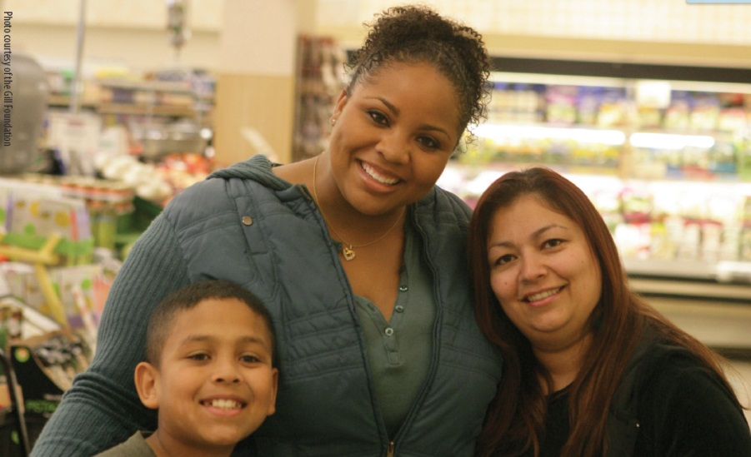
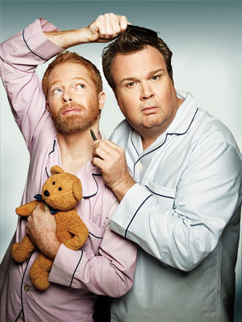
Don’t let these families be the only new normal…
These are also modern families…

Slide 32
Identifying LGBT People in Evaluation Research: What, When, & How to Ask

Slide 33
2 Key Questions
What do you want to assess?
What is your sample?

Slide 34
2 Key Questions
What do you want to assess?
Sexual orientation:
Identity?
Attraction?
Behavior?
Gender:
Gender identity?
Transgender status? (identity, or assigned sex/gender non-alignment?)
Gender expression/ gender nonconformity
What is your sample?

Slide 35
2 Key Questions
What do you want to assess?
Sexual orientation:
Identity?
Attraction?
Behavior?
Gender:
Gender identity?
Transgender status? (identity or assigned sex/gender non-alignment?)
Gender expression/ gender nonconformity
What is your sample?
LGBT specific or general population?
Age range?

Slide 36
Identifying LGBT People in Evaluation Research: What, When, & How to Ask
Adults

Slide 37
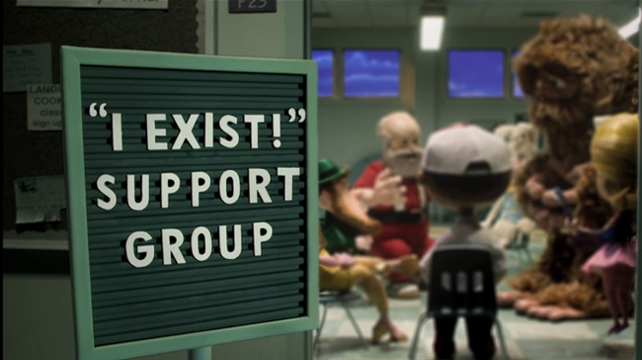
Measuring Sexual Identity & Gender
Notes:
That little story emphasizes something that most of you already realize…your program or evaluand is already serving LGBT people, it’s just that we’re often not measuring them.
The importance of “PASSING” and how passing impacts LGBT issues cannot be overstated here…not every LGBT person can be easily picked out of a crowd
The fact that we don’t have reliable population numbers for each state means we have no referent population…for all the stats oriented people in the room, you get why that’s such a problem
Means we don’t have a “normed” standard based on representative data
Also means – from a political standpoint – that we are wiped out of the equation…often heard that we just don’t exist in some states, similar to Santa Clause & the Easter Bunny

Slide 38
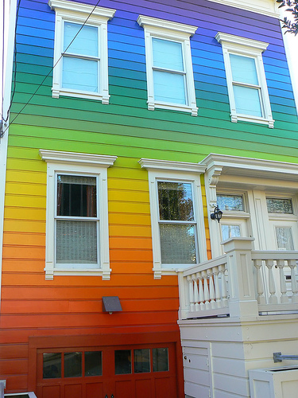
Focus on Sexual Identity
Assessing the “LGB” & “Q” parts of the community
Lack of national data & estimates for sexual minorities
Sexual orientation not included on U.S. Census / American Community Survey (ACS)
Same-sex households ≠ LGBQ individuals
No federal office oversees LGBT issues
Notes:
Left out of the federal structures…Office on Minority Health not focused on LGBT issues, nor is there a special initiative in Dept of Education looking at LGBT issues
This is tied to funding, to research & advancing the science, on monitoring & evaluation
According to revised estimates from the 2010 Census, there were 131,729 same-sex married couple households and 514,735 same-sex unmarried partner households in the United States.
Not currently assessed on any national health surveys
Included for the first time in Healthy People 2020
HHS plans to include sexual orientation / sexual identity on National Health Interview Survey (NHIS) in spring 2013
National Center for Health Statistics conducted assessment on measuring sexual identity in 2011

Slide 39
Assessing Sexual Identity
Issues & challenges
Fluid, dynamic & complex construct to measure
Missing data & misclassification
Personal beliefs & unfounded fears
Current recommendations
Be clear in what you want to asses…identity vs. behavior vs. attraction vs. community affiliation
Ask for what you want to know… “Do you consider yourself” or “Do you think of yourself as”
Do not solely use the terms “heterosexual” and “homosexual”
Include terms “straight” and “lesbian or gay”
Offer option of “Something else” (not “Other”)
Place non-minority response lower in response option list
Notes:
BACKGROUND:
Important to remember that a “Don’t know” or “Not sure” can mean two very different things
Someone questioning their sexual orientation or identity ➔ this is a valid response that could be coded to “Q” and added into the LGBQ group
Someone might not understand the question...associated with age, some ethnic groups, other demographics
Think that “Bisexual” means “between a man and a woman” while others might think it’s related to attraction or behavior and not identity
Beliefs
Already touched on the political beliefs & how that can impact even including items on surveys or assessment tools
Also some might think “We can’t ask that – it will make some people mad or freaked out”…shown the feasibility of asking sexual orientation on statewide surveys (BRFSS)
Place non-minority response lower in response option list reasons
The first, and most obvious, reason is that because the heterosexual option reads ‘straight, that is, not gay,’ and, therefore, requires the ‘gay’ option to be listed previously.
The second reason, and related to the first, is that respondents engage in satisficing, that is they look for the first option that is reasonable, even if not optimal (Tourangeau, Rips, and Rasinski, 2000). By placing the non-minority response lower in the list it encourages respondents to more deeply consider previous response options

Slide 40
Recommended Adult Item – Sexual Identity
“Do you think of yourself as:
Gay or lesbian
Straight, that is not gay or lesbian
Bisexual
Something else
Not sure”
*******************************************************************************************
Could have gender-specific response options
Branching option for responses d & e
Allows you to meaningfully categorize those respondents
Notes:
Let’s be clear – this is just sexual identity, not sexual behavior, nor attraction
Overlap between identity & behavior is highly correlated, but certainly not a “perfect fit” … many straight-identified folks have same-sex sexual contact and there are many gay/lesbian folks who have sexual contact with opposite sex partners

Slide 41
Do You See What I See?
Focus on the “T” and “Q”
Trans invisibility
In heteronormative society
In LGBT communities
Diversity within transgender communities
Not every transgender person wants hormonal or surgical body modification
Someone who does not want to be a woman might not necessarily want to be a man
New to our societal discourse
Gender is an old concept, but…
Measurement is under construction, in flux, dynamic
Notes:
Trans invisibility
Story of “Steve” who came out in his 60s as a transman who had transitioned in his early 20s, married to a woman, 3 kids, church pastor
Ignorance within LGBT communities about transgender issues…danger of ”checkbox” mentality of some sexual minorities
Important to remember that “Transgender” is an umbrella term covering many people & constructs
We have the first openly transgender mayor in Oregon…identifies as transgender, uses male pronouns, but presents as a woman
Importance of queer theory & the queer movement
Some in our LGBT communities don’t want to be labeled and believe their entire gender & sexual identity is just “queer” or “something else”
Others just don’t believe in the binary gender categories & see a spectrum
No single agreed upon item that has been validated, tested and found to be reliable and respectful
People have very strong emotions, but tough to find 10 trans folks & 10 researchers who all agree upon “Best Practices”

Slide 42
Assessing Gender & Sex
Important to decide what aspect of gender or sex is important to evaluation questions
Gender identity
Transgender status or history (as opposed to identity)
Gender expression
LGBT community affiliation
Make sure response options fit the construct
Male, Female, Something else
Male, Female, Intersex/Ambiguous
Masculine to Feminine scale
Might need multiple items to get info you need
Sex at birth PLUS Gender identity PLUS Transgender status
Notes:
Trans-inclusive response options…but don’t forget some (many?) trans folks might have a binary gender identity of male or female might not identify as transgender
Important to remember if you’re working in health-related issues where biological / medical history can influence health outcomes
Someone who identifies as a male but was raised as a female & still has lady bits that need tending to in a medical context
Response options
Might only want to have “Male, Female, More complicated” as options
If you’re asking about Sex at birth, do not offer Trans…technically more appropriate to offer Intersex/Ambiguous
If you absolutely cannot add another item to assess transgender status, might want to consider using a “check all that apply” (though some argue against that)

Slide 43
Transgender Status Item - Massachusetts
“Some people describe themselves as transgender when they experience a different gender identity from their sex at birth. For example, a person born into a male body but who feels female or lives as a woman. Do you consider yourself to be transgender?
No
Yes, transgender male to female
Yes, transgender female to male
Yes, transgender do not identify as male or female
Not sure”
Notes:
MASSACHUSETTS item
‘‘Some people describe themselves as transgender when they experience a different gender identity from their sex at birth. For example, a person born into a male body, but who feels female or lives as a woman. Do you consider yourself to be transgender?’’

Slide 44
Gender Items - Oregon
What was your sex at birth?
Male
Female
Intersex/Ambiguous
Some people identify as transgender if they have a different gender identity from their sex at birth. Do you consider yourself to be transgender?
Yes
No
Not sure
Notes:
We started out with the following and changed it which reduced confusion: “What sex were you assigned at birth?”
Used community-driven process to generate & develop two items
Started with existing items from Massachusetts, the Williams Institute, and CDC
Compiled these items under each “item topic” (sex at birth, and trans status)
Conducted eight key informant interviews (each lasting around 45 minutes) with transgender community members to gather input on existing items and offered them an opportunity to change these items or add their own suggested items
Key informants included academics, researchers, activists, clinicians, and public health professionals, all of whom were part of the transgender community (Notably, some of our informants had current binary gender identities and were straight-identified, so we developed items that would capture respondents who might not identify as transgender but have a discordant current gender identity from birth sex)
After all possible items were developed, a larger group of key informants (some of whom were not transgender) voted on their top two items

Slide 45
Trans-Inclusive Items in Evaluation
Challenge to balance reliability & respect in a statewide phone-based health survey
Some terms can act as “flags” that a survey or a program is trans-inclusive (a.k.a. “What sex were you assigned at birth?”)
However, that same language might confuse others
General population appear to be accepting of transgender items
Far fewer refusals than income & weight questions!
One more reason to use participatory approach
Community-driven item development was time-consuming but entirely worth it
Ownership & engagement of trans community leaders

Slide 46
Notes:
A few things to keep in mind to help LGBT count in our society:
Incredibly powerful to see ourselves on surveys, intake forms, participant demographic tables
From binary bathroom choices of “Men” or “Women” to being asked about marital status & being considered “Single” though you’ve been with your partner for 20 years…we are used to being invisible
Your choices in your “Participant Demographics” section have political implications
Not everything is black & white, male & female
Within LGBT communities there is incredible diversity
Challenge assumptions & ask questions respectfully
Some of these are just recommendations – suggestions might not work with your population or in your evaluation so engage your local LGBT community in planning & interpretation

Slide 47
Identifying LGBT People in Evaluation Research: What, When, & How to Ask
Youth

Slide 48
Items should . . .
Not be stigmatizing or troublesome to LGBT youth
Not conflate sexual orientation and gender
Allow for youth who do not identify at LGBQ or straight and those who do not identify as male, female, and/or transgender
Multi-check
“Other,” write-in
Be understandable
Definition (i.e., of transgender)
Reading level
Notes:
Similar considerations with adults, but additional issues.

Slide 49
Sample Items

Slide 50
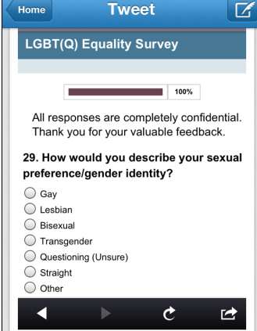
What do we think?

Slide 51
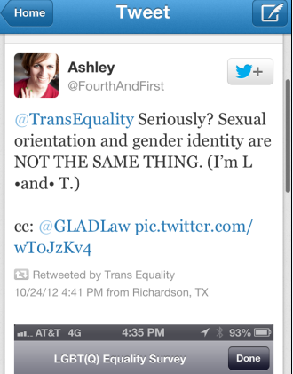
What did research subject think?

Slide 52
Sample Items
Sexual Orientation (Identity)
Gender Identity
Transgender Status
How would you describe your sexual orientation or sexual identity?
Heterosexual or Straight
Gay or Lesbian
Bisexual
Not Sure
Something Else (please describe: _____________________)

Slide 53
Sample Items
Sexual Orientation (Identity)
Gender Identity
Transgender Status
How would you describe yourself? (check all that apply)
Heterosexual or Straight
Gay
Lesbian
Bisexual
Queer
Questioning
Something Else (please describe: _____________________)

Slide 54
Sample Items
Sexual Orientation (Identity)
Gender Identity
Transgender Status
What sex are you?
Male
Female

Slide 55
Sample Items
Sexual Orientation (Identity)
Gender Identity
Transgender Status
What sex are you?
Male
Female

Slide 56
Sample Items
Sexual Orientation (Identity)
Gender Identity
Transgender Status
What is your gender? (check all
that apply)
Male
Female
Something Else (please describe: ____________)

Slide 57
Sample Items
Sexual Orientation (Identity)
Gender Identity
Transgender Status
What is your gender? (check all
that apply)
Male
Female
Something Else (please describe: ____________)
OR
Boy/Man
Girl/Woman
Something Else (please describe: ____________)

Slide 58
Sample Items
How would you describe your gender? (check all that apply)
Male
Female
Transgender
Transgender Male-to-Female
Transgender Female-to-Male
Genderqueer
Gender Nonconforming
Something Else (please describe: ____________)
Sexual Orientation (Identity)
Gender Identity
Transgender Status

Slide 59
Sample Items
Sexual Orientation (Identity)
Gender Identity
Transgender Status
Are you transgendered?
Yes
No
Notes:
Transgender as an adjective, not a verb, nor a noun

Slide 60
Sample Items
Sexual Orientation (Identity)
Gender Identity
Transgender Status
Are you transgendered?
Yes
No

Slide 61
Sample Items
Sexual Orientation (Identity)
Gender Identity
Transgender Status
When a person's sex and gender do not match, they might think of themselves as transgender. Sex is what a person is born. Gender is how a person feels. Are you transgender?
Yes
No
Not Sure

Slide 62
Sample Items
Sexual Orientation (Identity)
Gender Identity
Transgender Status
When a person's sex and gender do not match, they might think of themselves as transgender. Sex is what a person is born. Gender is how a person feels. Which one response best describes you?
I am not transgender
I am transgender and identify as a boy or man
I am transgender and identify as a girl or woman
I am transgender and identify in some other way

Slide 63
Additional Considerations with Youth
Parental Consent/IRB Issues
May be able to advocate to waive parental consent
Influences of Data Collection Site
School vs home computer (private?) vs youth group

Slide 64
Additional Considerations with Youth
Parental Consent/IRB Issues
May be able to advocate to waive parental consent
Influences of Data Collection Site
School vs home computer (private?) vs youth group
Fluidity of Identity/Rejection of Labels
A priori thinking re if/how to categorize
“Joke” Responses
Consider how to minimize and/or data triangulation

Slide 65
Additional Considerations with Youth
Parental Consent/IRB Issues
May be able to advocate to waive parental consent
Influences of Data Collection Site
School vs home computer (private?) vs youth group
Fluidity of Identity/Rejection of Labels
A priori thinking re if/how to categorize
“Joke” Responses
Consider how to minimize and/or data triangulation
Resistance to asking LGBT-related items
Anticipate, Advocate, Alternatives

Slide 66
For Further Discussion

Slide 67
Special Topics
To “Other” or Not to “Other”
Exploring when to include an “other” category, why to include it, how to ask it, and what to do with it in coding/analysis
Let’s Ask About Sex
Making sexual behavior items applicable and relevant to LGBT people
Where Do I Find Them?
Challenges, considerations, and innovative methods for specifically sampling and recruiting for LGBT people

Slide 68
Questions?

Slide 69
Thank you so much for your participation!
Feel free to contact us with any further questions!
Kari Greene: kari.greene@state.or.us
Efrain Gutierrez: efrain.gutierrez@Fsg.org
Emily Greytak: egreytak@glsen.org

